Slide 1
ForC PowerPoint
Classroom PPT and supplemental information for the ForC education modules

Slide 2
Table of contents
Plant Productivity --- slide 3
Earth’s CO2 --- slide 4
The Process of Science --- slide 5
The Carbon Cycle --- slide 6
ForC Introduction --- slide 17
ForestGEO --- slide 18
Structured Inquiry --- slide 20
Guided and Open Inquiry --- slide 41
Carbon Footprint --- slide 50

Slide 3
Plant Productivity in a Warming World
Before the video even begins write some predictions on what impacts a warming world might have on plant production
When did instrumental measurements begin?
What happens to plant growth as temperatures begin to rise?
What is primary plant production?
Where in the world was there a net increase in primary production? A net decrease?
What is happening to the plant primary production globally? Why?
Notes:
https://svs.gsfc.nasa.gov/vis/a010000/a010600/a010630/index.html

Slide 4
A Year in the Life of Earth’s CO2
Before the video begins predict what will happen to Earth’s carbon dioxide concentrations over the course of a year.
What happens to the carbon dioxide emitted from fossil fuel combustion?
Watch the video carefully and write down quick notes on what you’re seeing as the year progresses. Note months with high and low concentrations. Write down as many observations as you can. Be sure to write down any major changes or anything you hear that is surprising.
What is happening to the concentrations of carbon dioxide in the air?
Notes:
https://svs.gsfc.nasa.gov/cgi-bin/details.cgi?aid=11719

Slide 5
The Process of Science
1 Question
2 Research
3 Hypothesis
4 Develop protocols
5 Collect Data
6 Process Data
7 Analyze Data
8 Conclusion

Slide 6
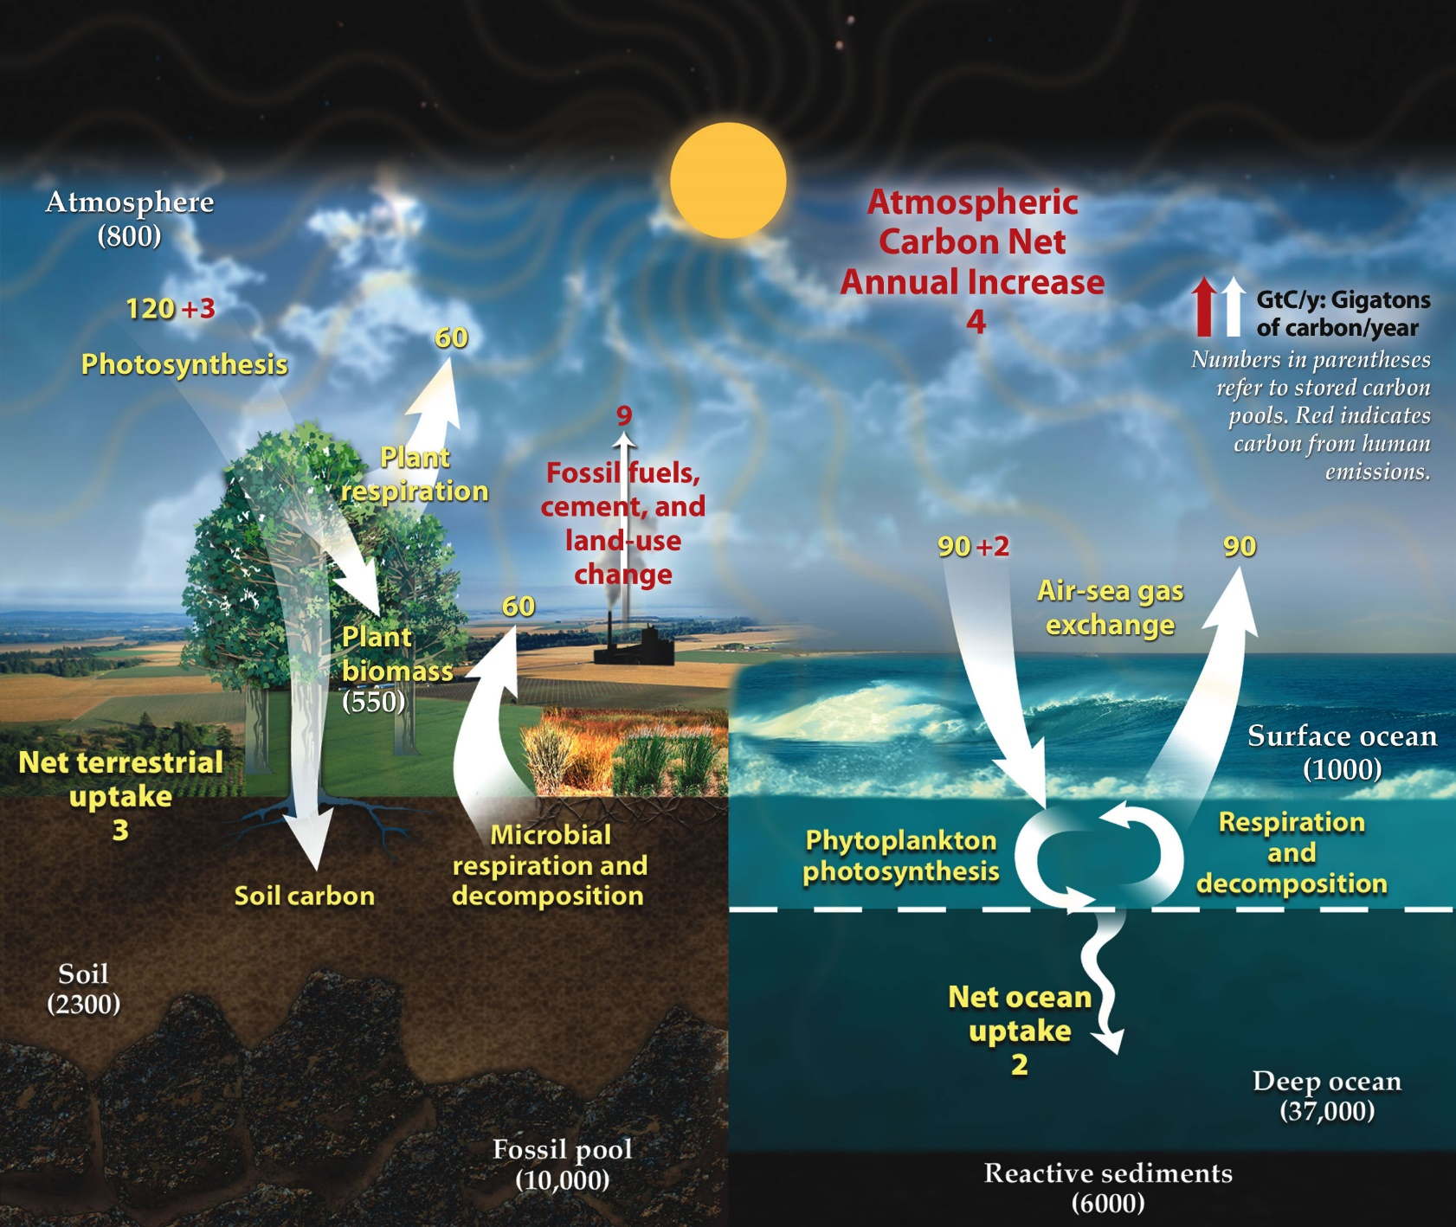
The Carbon Cycle
Notes:
Make sure to review https://en.wikipedia.org/wiki/Carbon_cycle or your textbook for basic info on the carbon cycle.
Main reservoirs:
Atmosphere (gas, CO2 and others)
Terrestrial biosphere (organic carbon in living things)
Ocean (dissolved in water)
Earth’s interior (limestone, fossil fuels)

Slide 8
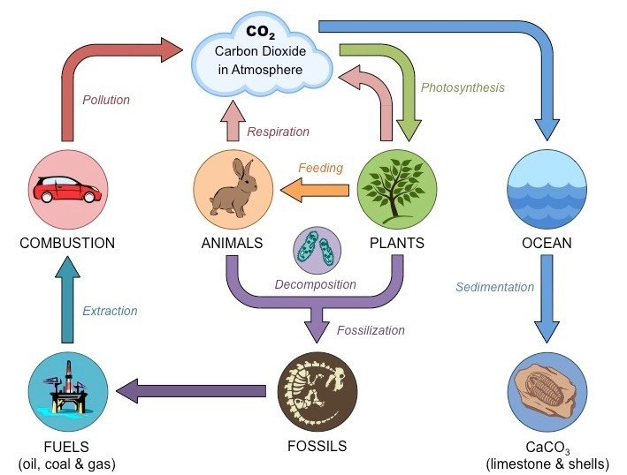

Slide 17
ForC: The Forest Carbon database
ForC is an open-access database containing over 17,367 records from 2,731 plots in 826 geographically distinct areas.
All data in ForC comes from published research by accredited scientists.
This database covers all forested biogeographic and climate zones
ForC can be used for ecological analysis of forest carbon cycling, evaluating models and remote sensing, and supporting international efforst to inventory forest carbon and greenhouse gas exchange.

Slide 18

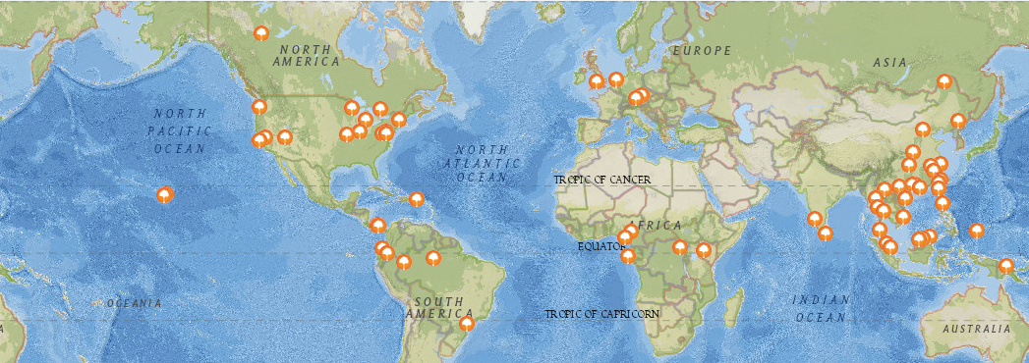
The Forest Global Earth Observatory (ForestGEO), previously known as Center for Tropical Forest Science (CTFS), is a global network of forest research sites and scientists dedicated to the study of tropical and temperate forest function and diversity.
The multi-institutional network comprises 66 forest research sites across the Americas, Africa, Asia, Europe, and Oceania
ForestGEO monitors the growth and survival of approximately 6 million trees and nearly 13,000 species that occur in the forest research sites.
A map of all ForestGEO sites
Notes:
https://forestgeo.si.edu/

Slide 19
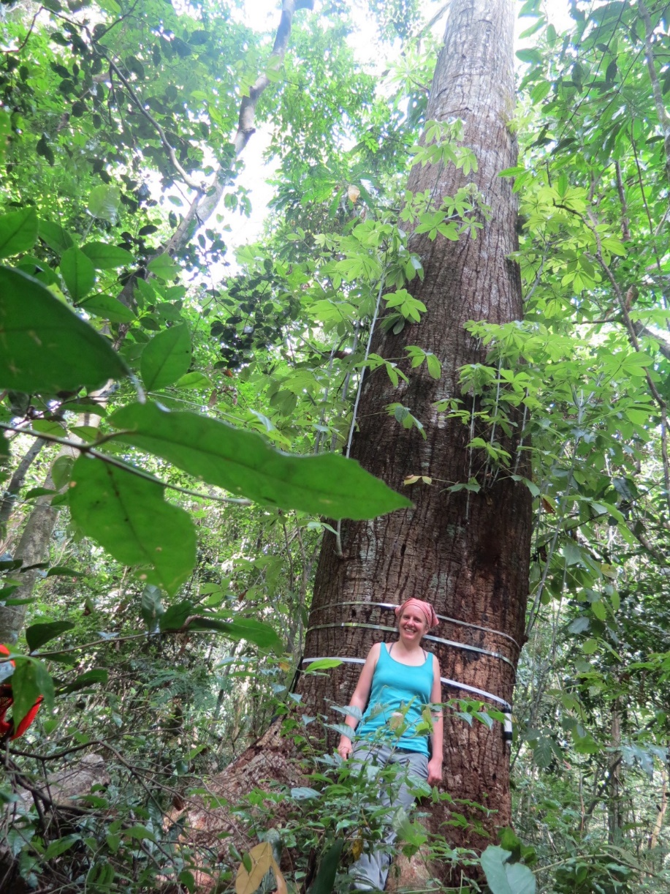
ForC and ForestGEO: Researcher Spotlight
Dr. Kristina Anderson-Teixeira focuses in forest ecosystem ecology, global change ecology, and climate protection through forest conservation.
Her approach combines data synthesis and analysis, quantitative ecology, and field research and focuses on understanding how climate — and climate change — shape ecosystems, and how ecosystems in turn regulate climate.
She leads the Ecosystems & Climate Research Initiative for the Center for Tropical Forest Science-Forest Global Earth Observatory (CTFS-ForestGEO).
Her research themes include carbon cycling in forests worldwide, forest disturbance and recovery dynamics under a changing climate, and valuing forests for their climate regulation services.

Slide 20
Structured Inquiry
Your goal for today is to use the ForC database to investigate the impacts of temperature on Gross Primary Productivity (GPP)

Slide 21
Outline
Review the carbon cycle and process of science
Download raw data from the ForC github (GPP_and_Temp)
Process data in Microsoft Excel
Analysis, conclusions and discussion
Record observations and make a hypothesis

Slide 22
The Process of Science
1 Question
2 Research
3 Hypothesis
4 Develop protocols
5 Collect Data
6 Process Data
7 Analyze Data
8 Conclusion

Slide 24
Research Review
Notes:
Give students some time to think, pair, share or work in small groups to write down notes (time them). Then call on students to contribute to give you some important points to write down.

Slide 25
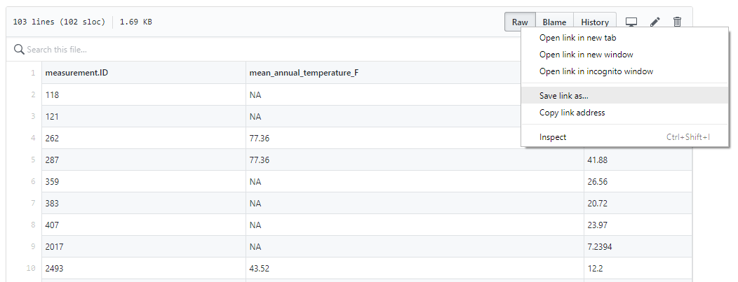
Download the Dataset: https://github.com/forc-db/ForC/blob/master/educational%20resources/ForC_GPP_and_temperature.csv
NOTE! Since ForC is often updated with new data your data might look different than the PPT, but your final graph should look similar
Notes:
(https://github.com/forc-db/ForC/blob/master/educational%20resources/ForC_GPP_and_temperature.csv)

Slide 26
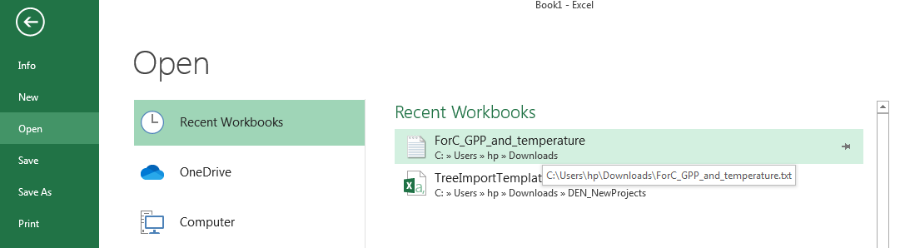
Import the data into Excel
Your data will automatically be saved as a text document
Load Excel and create a blank workbook
Click File and Open, find the downloaded text file (ForC_GPP_and_temperature), and click it

Slide 27
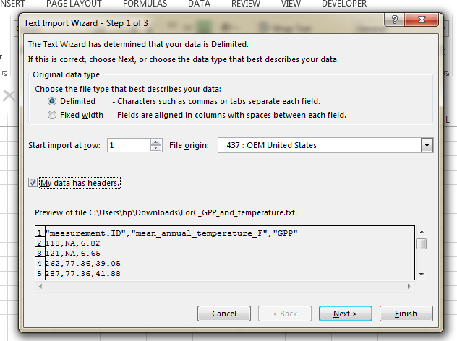
Fill out the Text Import Wizard
On step 1 of 3 , make sure Deliminated and My data has headers are both selected
Then click Next >

Slide 28
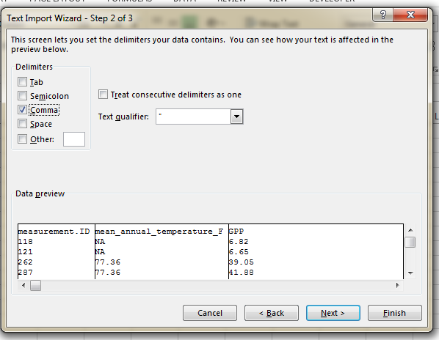
Fill out the Text Import Wizard
On step 2 of 3 click Comma and then Finish

Slide 29
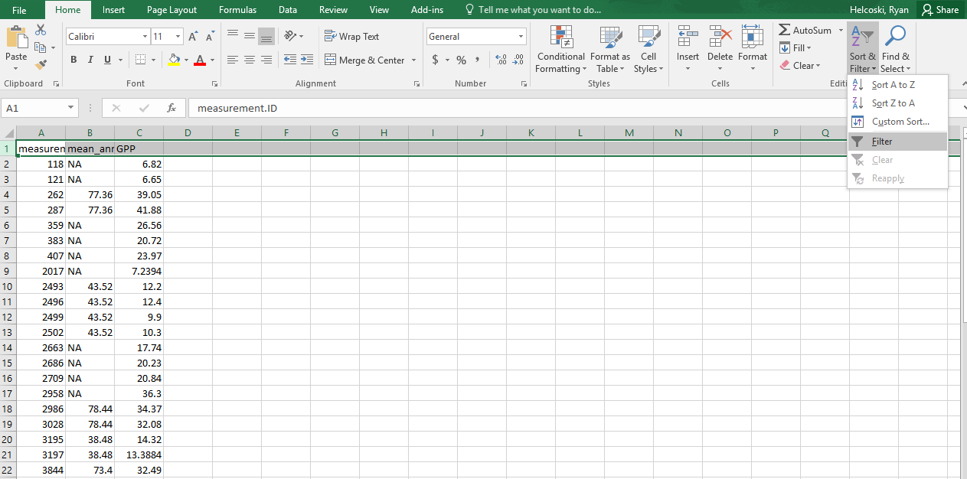
Create Filters

Slide 30
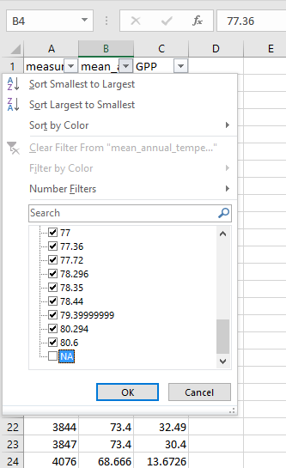
Search the columns
Search each column for any “NA” , “NAN” or similar values that indicate missing data.
Click the down arrow tap to open the drop box and then just click off the check mark in the appropriate box to remove the values.

Slide 31
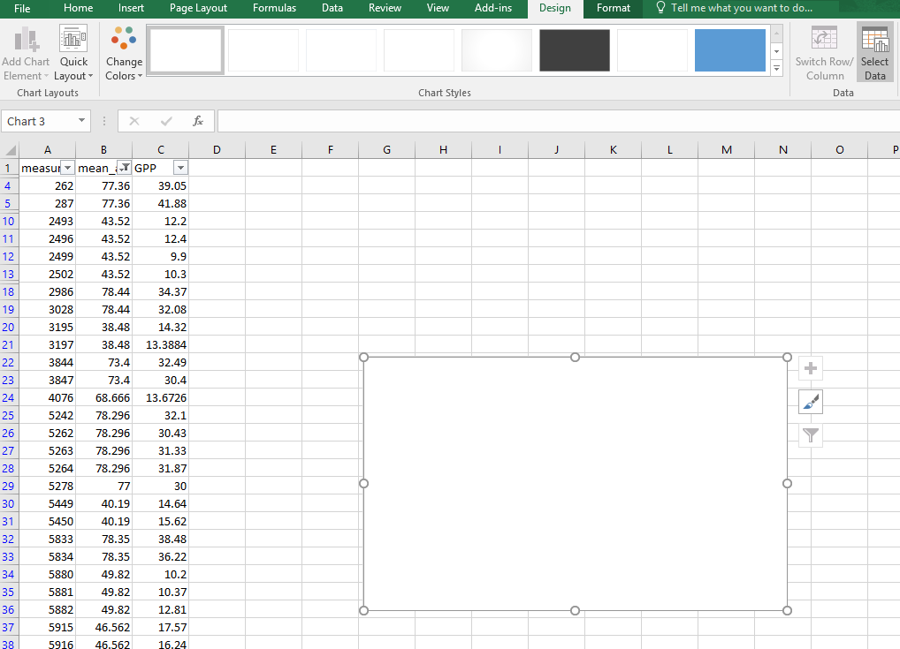
Create a Scatter Plot
Click the Insert tab
Then click Scatter and the first option
A black box should appear

Slide 32
Create a Scatter Plot
Next click the “select data” tab

Slide 33
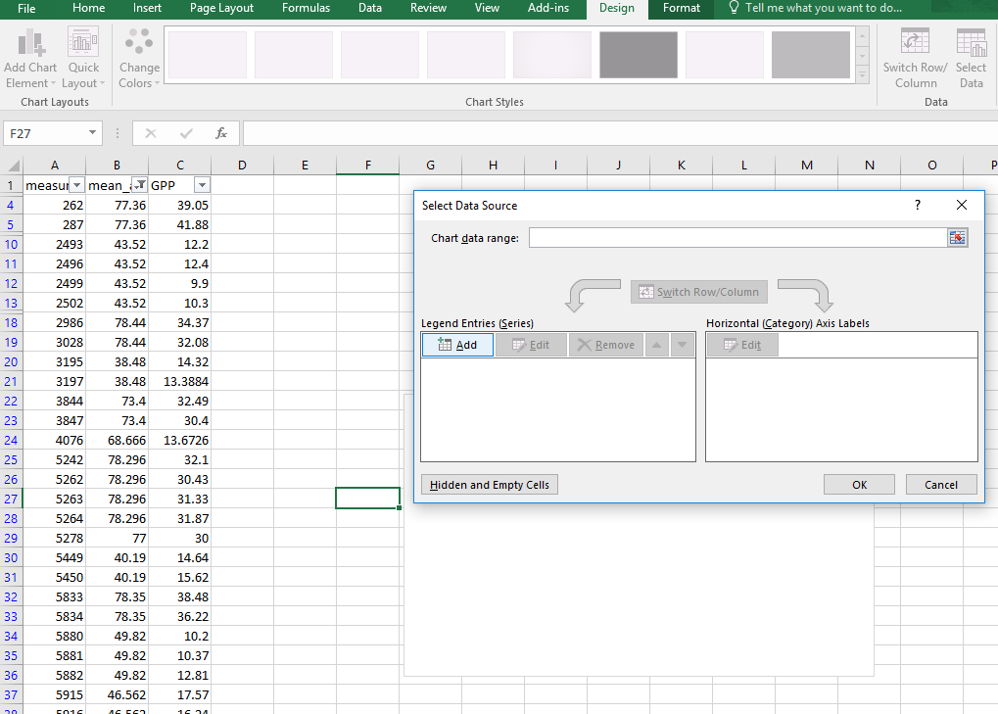
Create a Scatter Plot
Click the “add” tab

Slide 34
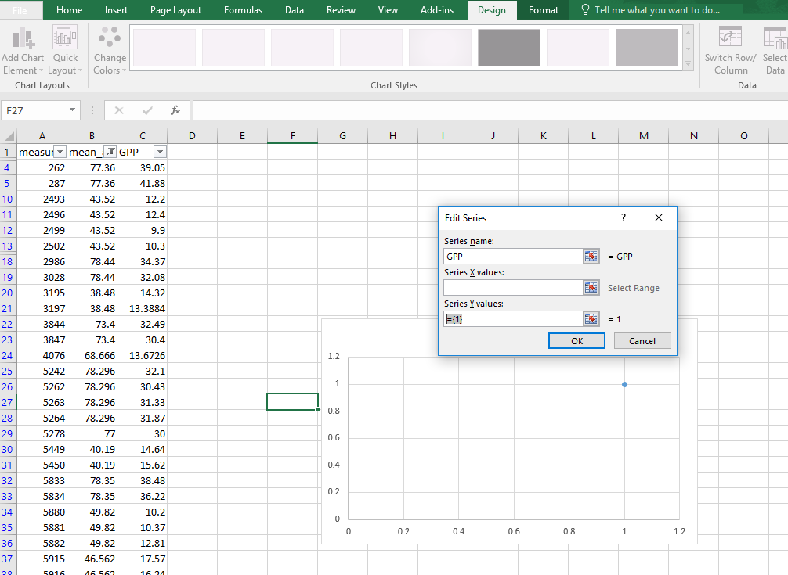
Create a Scatter Plot
Name the series GPP
Delete the series Y values if there is anything there (do not hit enter yet)

Slide 35
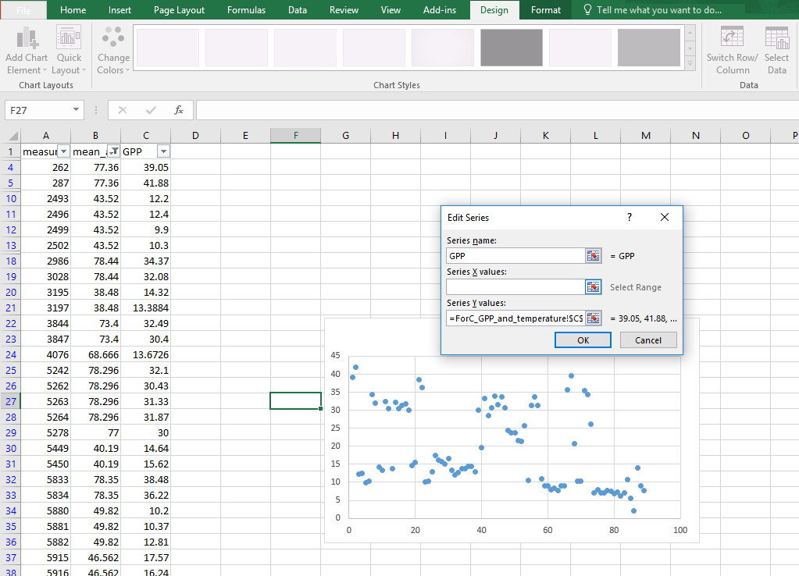
Create a Scatter Plot
Click the first value under GPP and scroll down to select all values in the column.
Next click the blank by the X value series

Slide 36
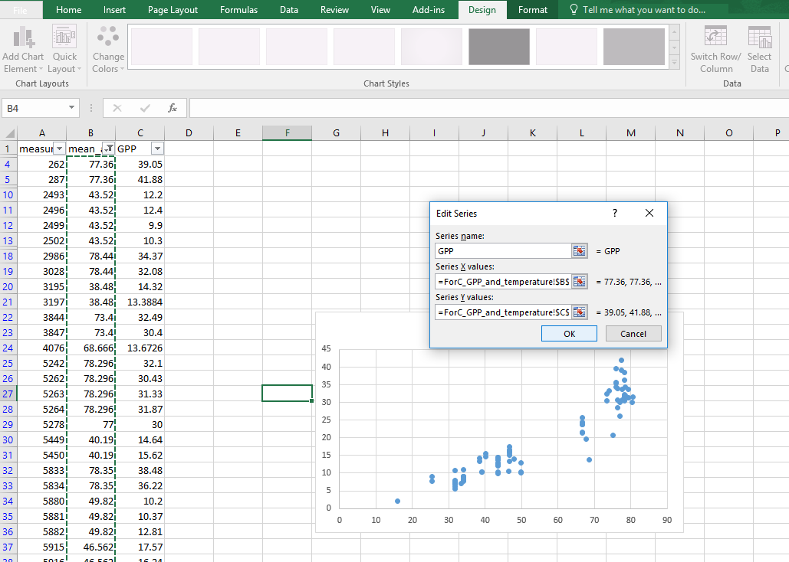
Create a Scatter Plot
High light the mean_temperature column for the X value
Click OK
Then Click OK again

Slide 37
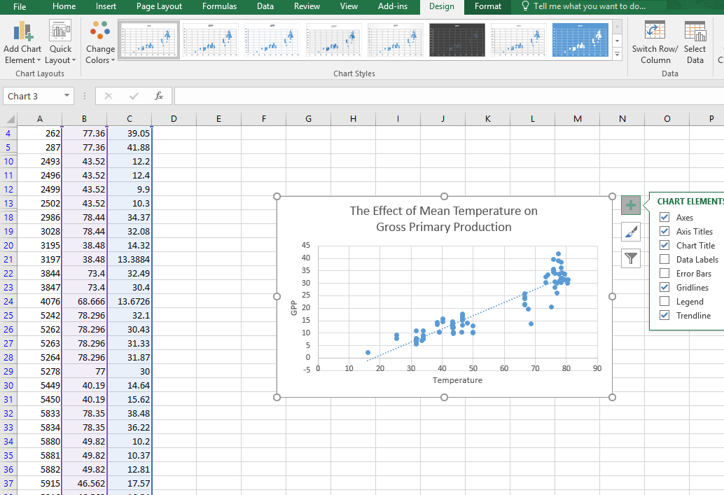
Create a Scatter Plot
Now click the + tab and add Axes, Axes Titles, Chart Title, and a Trendline.
Fill it out as seen here

Slide 38
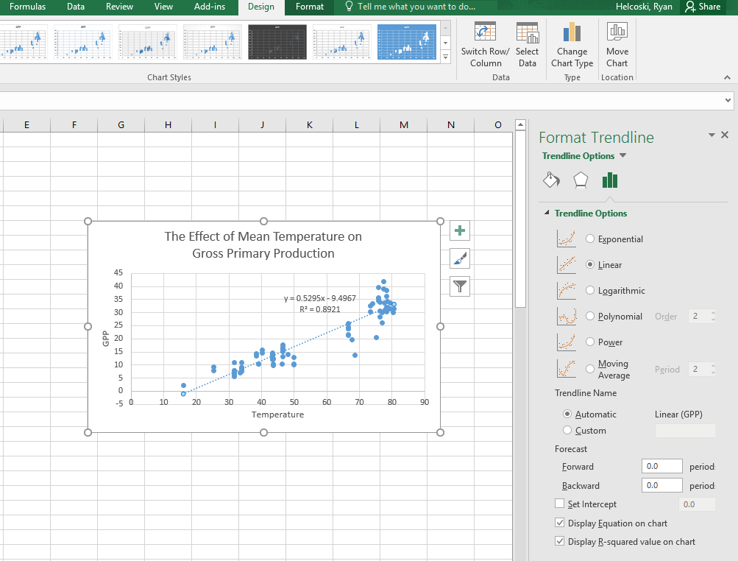
Create a Scatter Plot
Right click the dotted trendline and left click “Format Trendline”
Make sure to click the check for “Display Equation on chart” and “Display R-squared value”

Slide 39
Data Analysis
A linear regression line has an equation of the form Y = a + bX, where X is the independent variable and Y is the dependent variable. The slope of the line is b, and a is the intercept (the value of y when x = 0).
The R squared value is a statistical measure of how close the data are to the fitted regression line.
The R-squared is always between 1 and 0:
0 indicates that the model explains none of the variability of the response data around its mean.
1 indicates that the model explains all the variability of the response data around its mean

Slide 40
Things to remember (while writing your conclusion)
These data are for forests all over the world and the trend you see is real
However, this is not a time series so we can’t use it to make broad statements about the impacts of global warming
Avoid definitive statements such as “we proved,” in science we rely on data and we change our minds based on data. Your analysis doesn’t “prove” anything, but your data do “support” something and you can make some (relatively) secure assumptions based on it
Feel free to get help from others and discuss your work, but avoid plagiarism (plagiarism is an automatic ZERO)

Slide 41
Guided and Open Inquiry
Your goal today is to ask a question pertaining to the Forest Carbon Cycle and answer it using the ForC database.

Slide 42
Outline
Review the carbon cycle and process of science
Download raw data from the ForC github (GPP_and_Temp)
Process data in Microsoft Excel
Analysis, conclusions and discussion
Explore the Shiny App ,record observations, and make a hypothesis

Slide 43
The Process of Science
1 Question
2 Research
3 Hypothesis
4 Develop protocols
5 Collect Data
6 Process Data
7 Analyze Data
8 Conclusion

Slide 45
Roles
Though all group members are responsible for the final product you will need to assign different roles to be able to complete the assignment on time
Task Manager – In charge of communicating with the instructor and keeping the group on task. Must be organized and watch your time.
Lead Researcher – In charge of any research outside what is present in the lesson. Should be interested in past and future research
Lead Analyst – In charge of data analysis. Must have some background experience in Microsoft Excel or other programs.
Lead Presenter – In charge of organizing the PowerPoint presentation and introducing your question to the class
Notes:
Students choose their role. They are responsible for the assignment as a whole but are held accountable specifically for their contribution in their respective roles

Slide 46
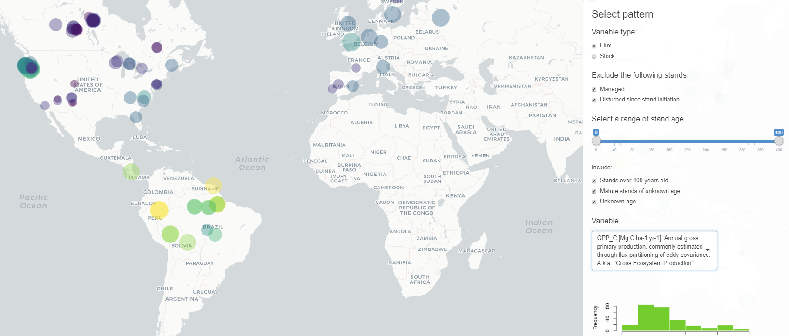
Exploring the Data
Load the ForC Shiny App and make sure to exclude managed and disturbed plots

Slide 47
Guidance in forming your Question
In GUIDED INQUIRY your question MUST be in the following format:
How does (variable.name) relate to mean temperature?
(or) precipitation?
(or) absolute latitude?
(or) biogeographic region?
*NOTE* You may choose any variable from the (variable.name) column as you dependent variable, but you MUST choose one of the four above as your independent variable.
Notes:
Make sure students do not ask the same question. Best to keep a list.)
For open inquiry, skip this slide!

Slide 48
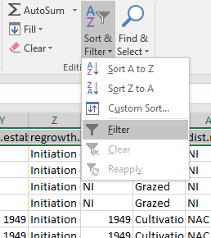
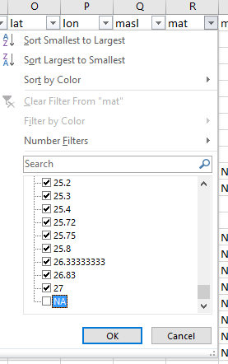
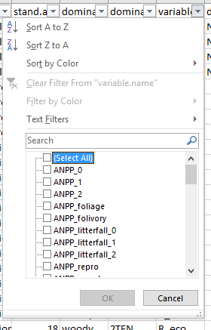
Data Processing and Analysis: After you have downloaded the data you need to find your variables
3) Find your independent variable and remove any “NA”, “NAN” or missing measurements
1) Click the “filter” button
4) Select all data (Ctrl + A) and copy (Ctrl + C) into a new spread sheet.
5) Create a scatterplot with your independent variable on the X axis and your dependent variable on the Y axis. Create a tendline and display the equation and R squared value
2) Click the down arrow by the variable.name and click (select All) to deselect all variables. Then check off your dependent variable
Notes:
NOTE! If students are struggling with creating a scatter plot you can go to slide 28 and explain it or digitally provide them with slides 28 - 36

Slide 49
Guidance on your presentation
Often times researchers must present their findings in short talks and it can be difficult to boil your findings down to 5 – 10 minutes
Plan on about 1 minute per slide and be sure to include the following:
1) Cover slide with your question and group members
2) Background slide (on your specific question, not ForC or ForestGEO)
3) A hypothesis slide that also explains your dependent and independent variables
4) A methods slide that (briefly) describes what you did in data processing and analysis
5) A conclusion slide that explains your findings
6) An extension slide that puts your study into the context of our global environment
7) A works cited slide that contains all references you used
Make sure your presentation is INTERESTING and don’t use TOO much text (for example, there is WAY too much text on this slide). You should know MORE than your PowerPoint. Remember that YOU’RE the star, NOT the PowerPoint.

Slide 50
Carbon Footprint
Your carbon footprint is the amount of carbon dioxide and other carbon compounds emitted due your consumption of fossil fuels as measured by the foods you eat, where you live, what transportation you use, what things you buy, etc.
There are many different websites that can be used to approximate your footprint.
Today we will be exploring a few different carbon footprint calculators

Slide 51

Acknowledgements
Co-authors: Ryan Helcoski, Kristin Black, Kristina Anderson-Teixeira
We would like to thank the following organizations for providing funding to make this endeavor possible

